Slide 1

THREE PHASE INDUCTION MOTOR

Slide 2

 Electrical Machines are Electromechanical energy converson devices.
 Electrical motor coverts electrical energy into mechanical energy and electrcal generators are vice versa.
 Most of the Industrial load are inductive, especially 3-ph induction motors are widely used in industrial applications for continious operation.

Slide 3


Principle of Operation
 A Rotating Magnetic field (RMF) is set up in the stator when a 3- Phase supply is given.
 The stationary rotor cut the revolving field and due to electromagnetic induction an e.m.f. is induced in the rotor conductor.
 As the rotor conductor is short circuited current flows through them.
 It becomes a current carrying conductor in magnetic field and start rotating.

Slide 4




Slip of an Induction Motor
Induction motor rotor always rotate at a speed less than
synchronous speed.
The difference between the flux (N_{s}) and the rotor speed (N) is called slip.
% Slip (s) = ^{Ns – N} *100
N_{s}
Where Ns=Synchronous Speed N= Actual Speed of rotor
Slip speed = N_{s} – N

Slide 5

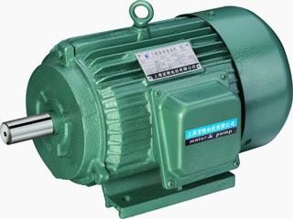

Slide 6

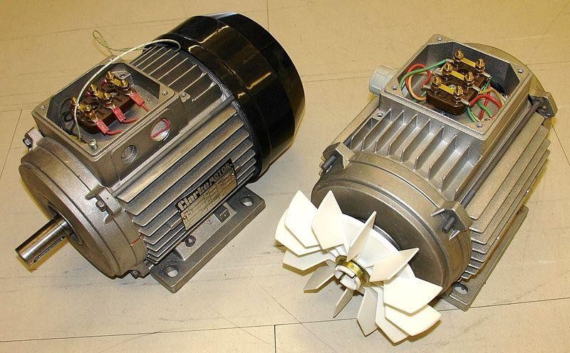

Slide 7
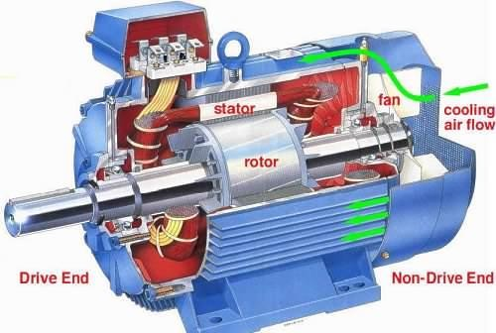

Slide 8
CONSTRUCTION OF 3- PHASE INDUCTION MOTOR
Frame
Stator
Stator Winding
Rotor
Rotor Winding
Cooling Fan
Bearings

Slide 9
Frame:
Frame provides mechanical support to the stator and rotor.
It is made from casting materials.
Stator:
It is stationary part of induction motor. It consists stator winding
It is housed on the motor frame.

Slide 10
Rotor:-
It is the rotating part of the induction motor.
It is housed on the shaft of the induction motor.
It has two ends, one is called Driving end and another is called non-
Driving end.
Mechanical load is connected on driving end while cooling fan is connected on non-driving end.
Both the ends are connected with bearings for free rotation means of reduced friction losses.
Arrangement of rotor of induction motor are given below:

Slide 11

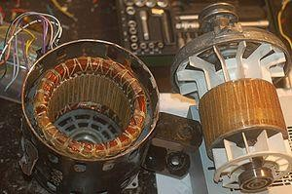

Slide 12
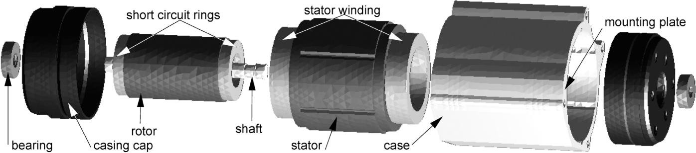

Slide 13
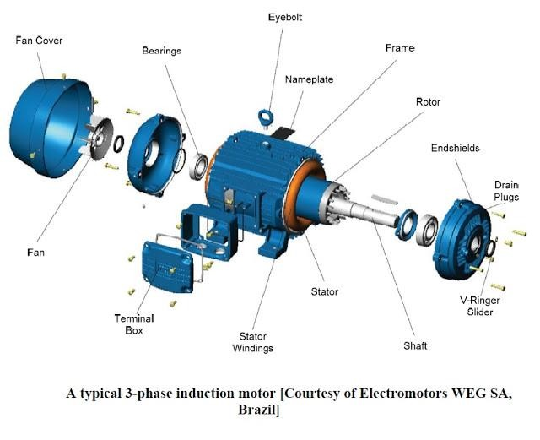

Slide 14

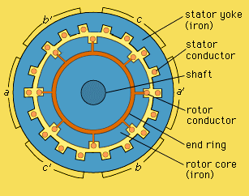

Slide 15

Stator Windings:
 Star connected
 Delta connected
Rotor Windings:
 It is wound as rotor bars and short circuited at both the ends through end rings.

Slide 16
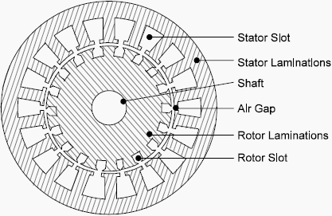

Slide 17
According to rotor construction it can be Classified in two category according to rotor Construction:-
Squirrel cage induction motor
Slip ring induction motor

Slide 18

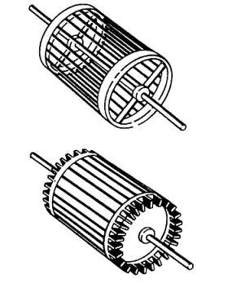

Slide 19
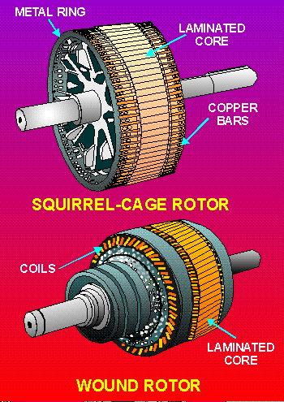

Slide 20
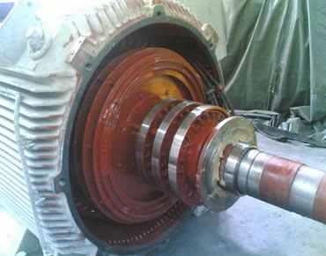

Slide 21
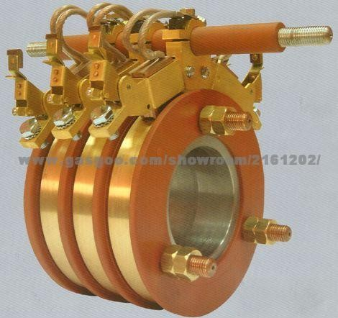

Slide 22

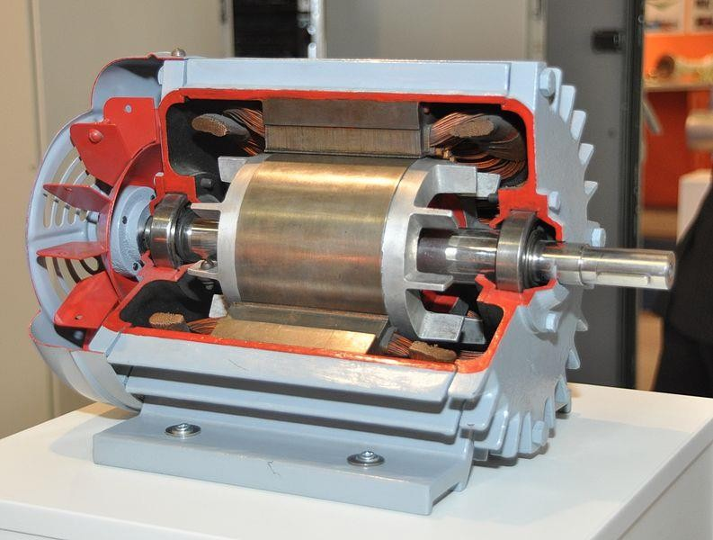

Slide 23

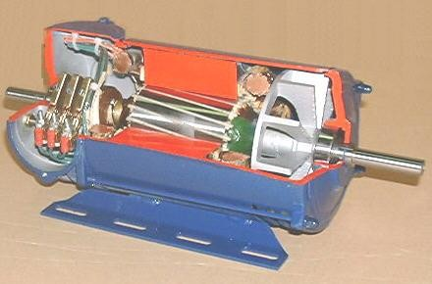

Slide 24

SQURELL CAGE INDUCTION MOTOR
Most of the application of industrial as well as domestic are this type of induction motor.
Its construction is simple and rugged.
Cheap copare to slipring IM
Maintenance is easy
Cost is less compare to slipring IM
Can use at explosive area
Starting torque is low compare to slip ring IM
Application:-
Leath machine, Compressors,centrifugal pump, in agriculture etc. where cost is most important factor

Slide 25
Slipring Induction Motor:-
It has high starting torque compare to squirrel cage IM
Construction is complicated
Maintanance cost is high compare to squirrel cage IM
Starter requires compulsory
Can not use at explosive area
Application:-
Crane,hoist,lift and wherehigh starting torque is required

Slide 26
Torque equation
The torque produced by three phase induction motor depends upon the following three factors:
The part of rotating magnetic field which reacts with rotor and is responsible to produce induced e.m.f. in rotor.
The magnitude of rotor current in running condition.
The power factor of the rotor circuit in running condition.

Slide 27
Combining all these factors, we get the equation of torque as-
Where,
T is the torque produced by the induction motor, φ is flux responsible for producing induced emf, I₂ is rotor current,
cosθ₂ is the power factor of rotor circuit.

Slide 28

The flux φ produced by the stator is proportional to stator emf E₁. i.e
φ ∝ E₁
We know that transformation ratio K is defined as the ratio of secondary voltage (rotor voltage) to that of primary voltage (stator voltage).

Slide 29


We know that power factor is defined as ratio of resistance to that of impedance. The power factor of the rotor circuit is
Putting the value of flux φ, rotor current I₂, power factor cosθ₂ in the equation of torque we get,

Slide 30


Removing proportionality constant we get,
Where, n_{s} is synchronous speed in r. p. s, n_{s} = N_{s} / 60. So,
finally the equation of torque becomes,

Slide 31


Equation of Starting Torque
Starting torque is the torque produced by induction motor when it starts. We know that at the start the rotor speed, N is zero.
So, the equation of starting torque is easily obtained by simply putting the value of s = 1 in the equation of torque of the three phase induction motor,
The starting torque is also known as standstill torque.

Slide 32

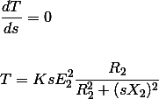
Maximum Torque Condition
In the equation of torque,
So, for torque to be maximum,

Slide 33
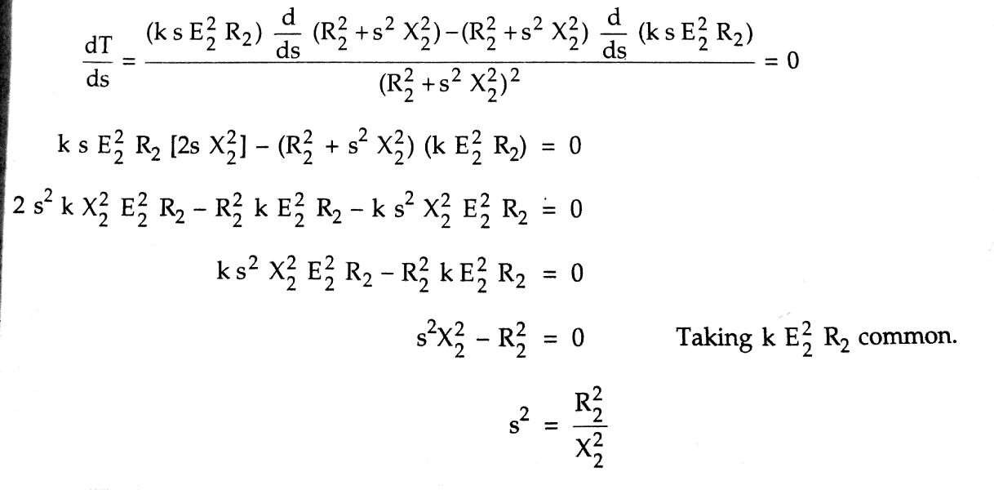
Maximum Torque Condition

Slide 34


Maximum Torque Condition
So, when slip s = R₂ / X₂, the torque will be maximum and this slip is called maximum slip Sm ,and it is defined as the ratio of rotor resistance to that of rotor reactance.
The equation of torque is
The torque will be maximum when slip s = R₂ / X₂ ,Substituting the value of this slip in above equation we get the maximum value of torque as,

Slide 35
Maximum Torque Condition
From the above equation it is concluded that The maximum torque is directly proportional to square of rotor induced emf at the standstill.
The maximum torque is inversely proportional to rotor reactance.
The maximum torque is independent of rotor resistance.
The slip at which maximum torque occur depends upon rotor resistance, R₂. So, by varying the rotor resistance, maximum torque can be obtained at any required slip.

